Slide 1
Cybersecurity in Senior Living
Taking Control: Mastering Cybersecurity in a Digital Age
FSA Annual Conference September 25, 2024

Slide 2

Speaker
John DiMaggio CEO, Blue Orange Compliance john.dimaggio@blueorangecompliance.com 2500 Farmers Drive Columbus, OH 43245 614.567.4109

Slide 3
Cybersecurity and HealthCare
Anatomy of a Cyber Attack
Government Actions and Regulations, Legal
Cyber Insurance
Artificial Intelligence
What To Do Now
Agenda
FSA 2024 – Blue Orange - Taking Control: Mastering Cybersecurity in a Digital Age

Slide 4
Cybersecurity
You have Something Valuable
Sensitive information
Protected information
Ability to operate business using technology
Reputation
Money, cyber insurance
Cyber criminals
In business to make money
Have tools, knowledge, tradecraft
Other Factors
Accidental, Environmental,
Vendors
Human Error
Storms, Tornados, Floods
Confidentiality
Integrity
Availability
FSA 2024 – Blue Orange - Taking Control: Mastering Cybersecurity in a Digital Age

Slide 5

Why is HealthCare a Target?
Relatively Weak Defenses
Valuable Data
Operational Urgency
Numerous Interfaces and Sharing
Everyone is a Target and No One is a Target
FSA 2024 – Blue Orange - Taking Control: Mastering Cybersecurity in a Digital Age

Slide 6
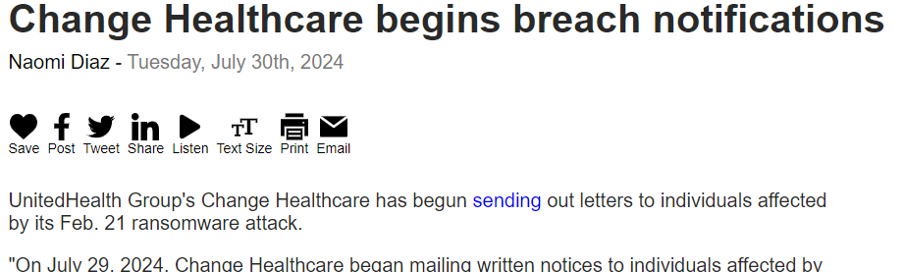
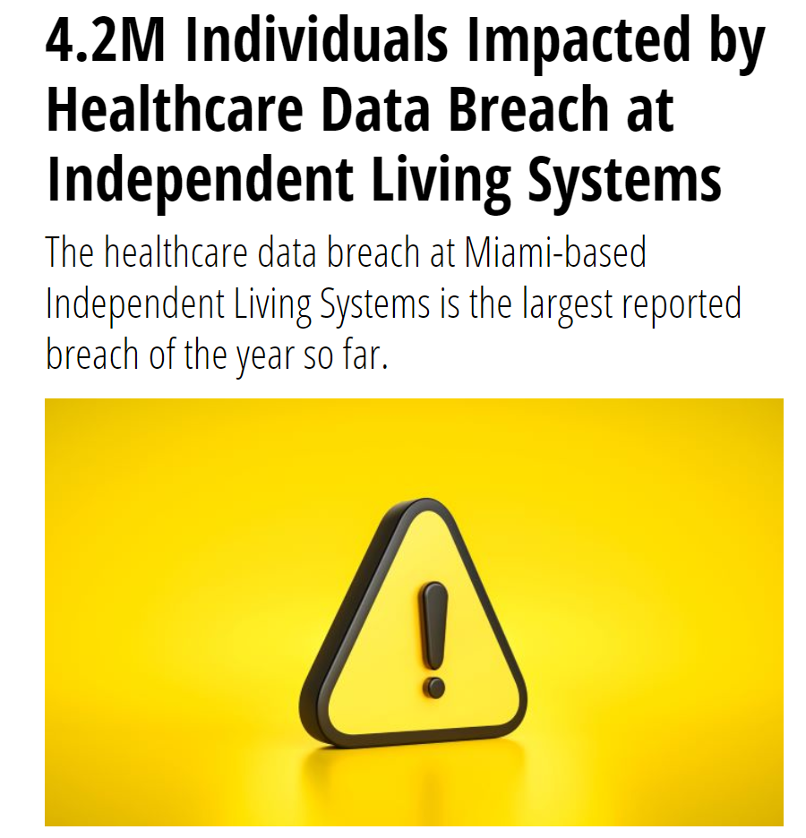
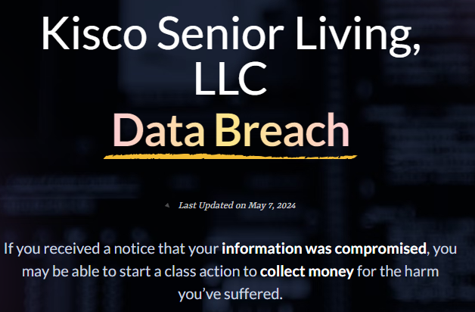
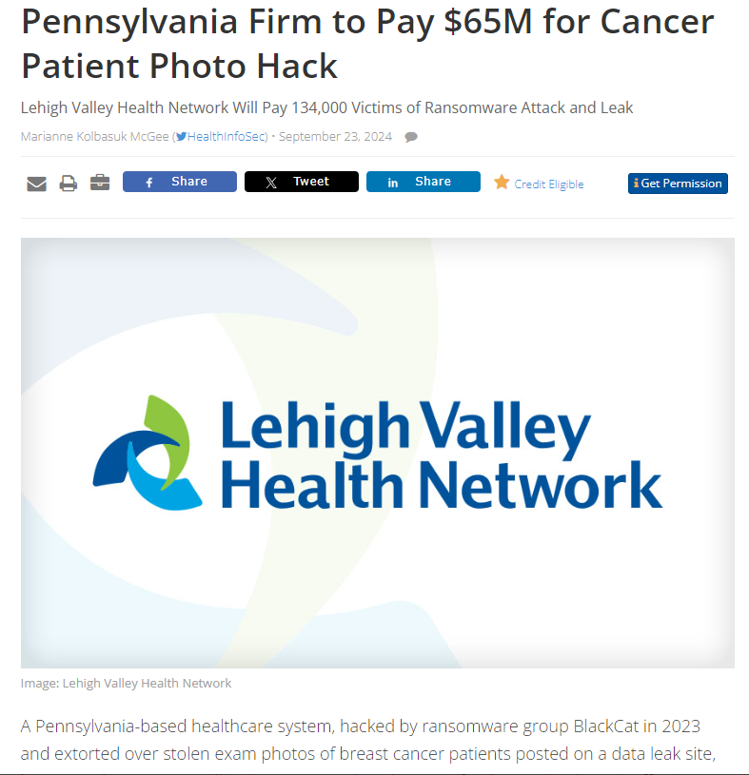
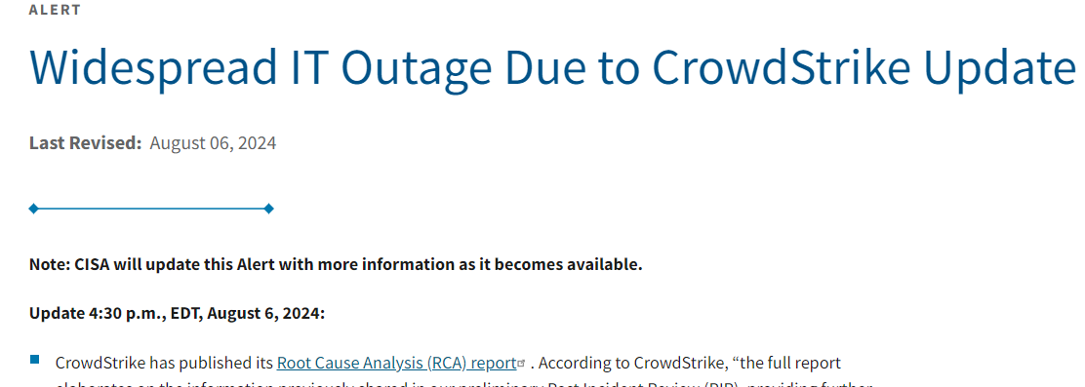
Why Now?
Source: https://healthitsecurity.com/news/4.2m-individuals-impacted-by-healthcare-data-breach-at-independent-living-systems
FSA 2024 – Blue Orange - Taking Control: Mastering Cybersecurity in a Digital Age

Slide 7
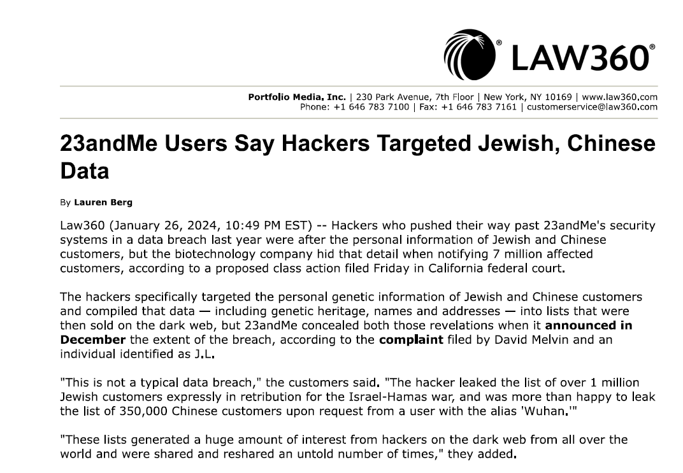
Even Scarier
FSA 2024 – Blue Orange - Taking Control: Mastering Cybersecurity in a Digital Age

Slide 8
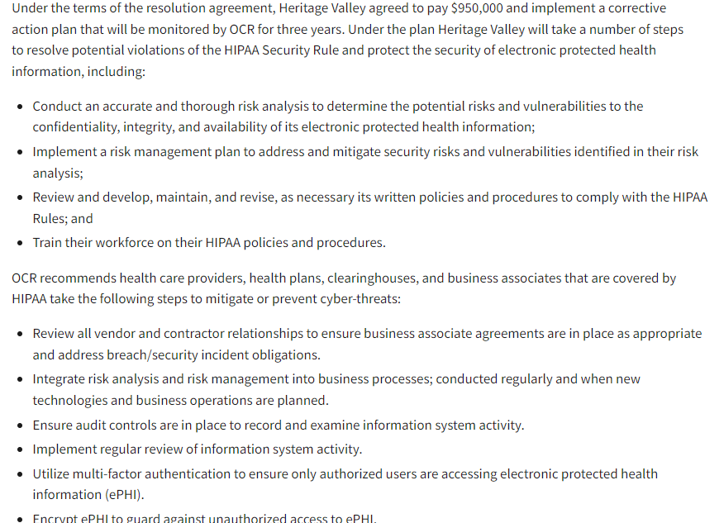
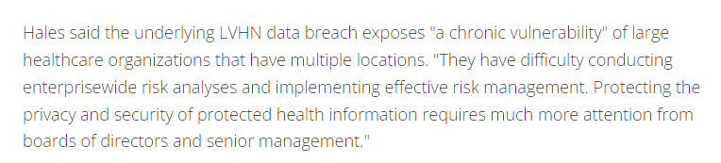
Common Theme
https://www.healthcareinfosecurity.com/pennsylvania-firm-to-pay-65m-for-cancer-patient-photo-hack-a-26345
https://www.hhs.gov/about/news/2024/07/01/hhs-office-civil-rights-settles-hipaa-security-rule-failures-950000.html

Slide 9

Cyber Attack/Incident Timeline
Today
Someday
Time
Pre-Attack/Incident
“Right of Boom”
Post-Attack/Breach “Right of Boom”
Cyber Attack/Incident
“Boom”
Time
FSA 2024 – Blue Orange - Taking Control: Mastering Cybersecurity in a Digital Age

Slide 10
Common Attack Vector (The Ways Bad Guys Get In)
You Give Them Your Password
They Guess Your Password
Your Password is on The Dark Web
Exploit known Vulnerability (Published But Patch Not Applied)
Click On a Bad Link Which Installs Malware on Browser
FSA 2024 – Blue Orange - Taking Control: Mastering Cybersecurity in a Digital Age

Slide 11
Cyber Attack/Incident Timeline (Ransomware Example)
Pre-Attack/
Incident “Left of Boom”
Cyber Attack/ Incident
Post-Attack/ Breach “Right of Boom/
Afterparty”
Breach Notification for any affected residents
Civil lawsuits
HIPAA Office for Civil Rights (OCR) investigation
Phishing email – User provided credentials
Attacker gains foothold and cracks admin passwords
Performs recon for files, systems high value data
Installs ransomware software
Downloads as much of your data as possible
Once complete, triggers ransomware which encrypts data
Users have trouble accessing systems
Ransom note displayed with demand and contact info
Contact cyber insurance
Attempt to restore system
Eradicate
Contact threat actors regarding ransom amount
Do they also have your data? Ask to provide proof
FSA 2024 – Blue Orange - Taking Control: Mastering Cybersecurity in a Digital Age

Slide 12
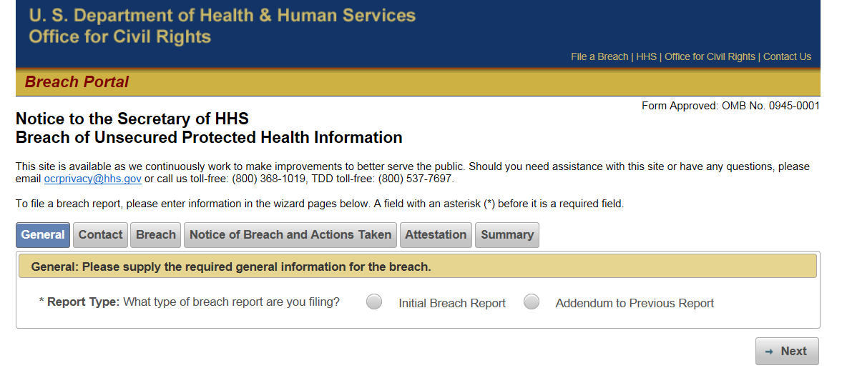
Afterparty: What To Expect When Submitting a Breach Report to The OCR
FSA 2024 – Blue Orange - Taking Control: Mastering Cybersecurity in a Digital Age

Slide 13
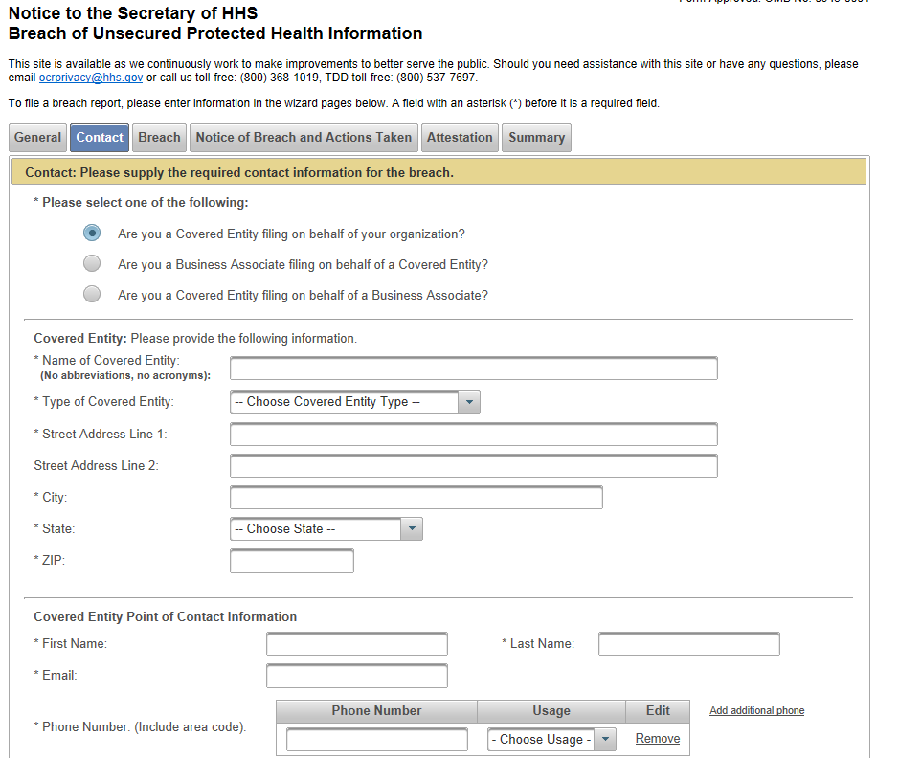
Afterparty: What To Expect When Submitting a Breach Report to The OCR
FSA 2024 – Blue Orange - Taking Control: Mastering Cybersecurity in a Digital Age

Slide 14
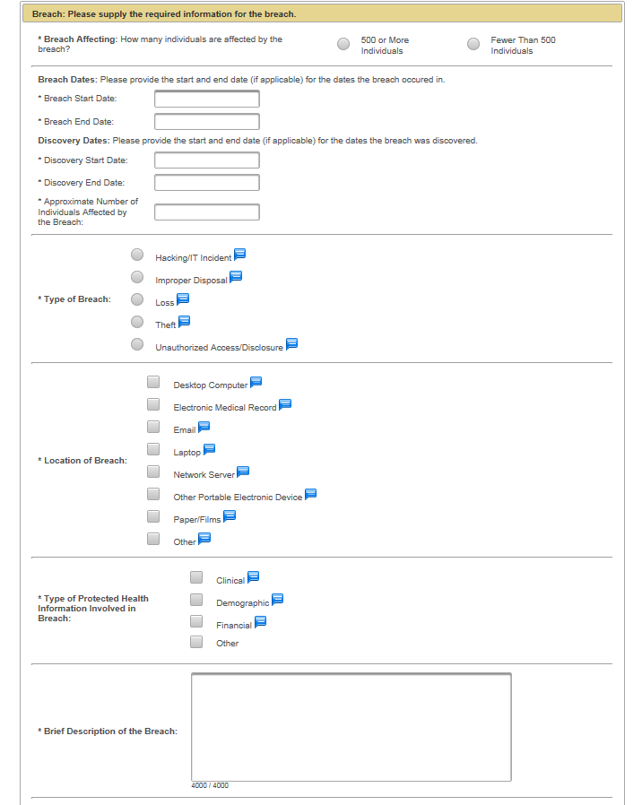
Afterparty: What To Expect When Submitting a Breach Report to The OCR
FSA 2024 – Blue Orange - Taking Control: Mastering Cybersecurity in a Digital Age

Slide 15
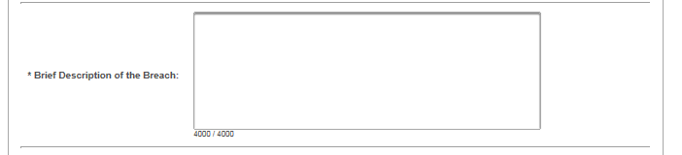
Afterparty: What To Expect When Submitting a Breach Report to The OCR
FSA 2024 – Blue Orange - Taking Control: Mastering Cybersecurity in a Digital Age

Slide 16
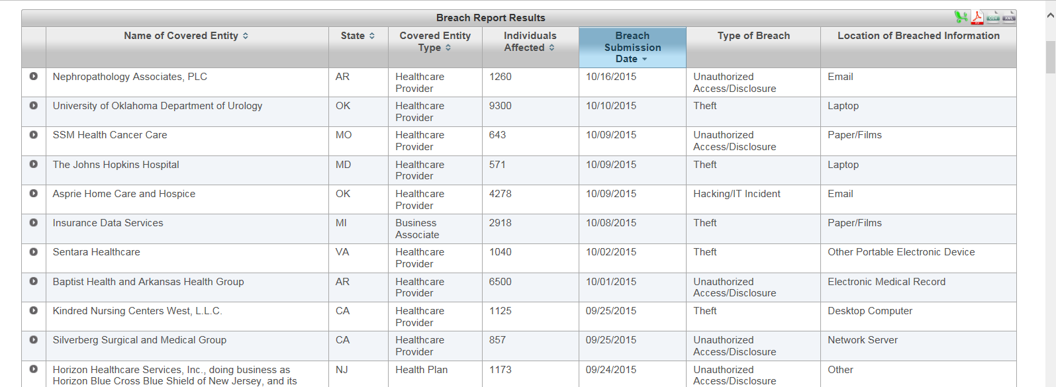
Afterparty: What To Expect When Submitting a Breach Report to The OCR
As required by section 13402(e)(4) of the HITECH Act, the Secretary must post a list of breaches of unsecured protected health information affecting 500 or more individuals. These 500+ breaches are posted in a accessible format that allows users to search and sort the posted breaches. Additionally, the posted list includes the brief summaries of the breach cases that OCR has investigated and closed, as well as the names of private practice providers who have reported breaches of unsecured protected health information to the Secretary.
FSA 2024 – Blue Orange - Taking Control: Mastering Cybersecurity in a Digital Age

Slide 17
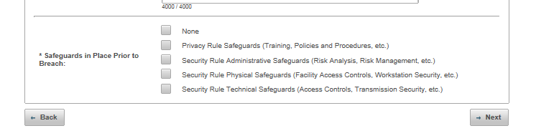
Afterparty: What To Expect When Submitting a Breach Report to The OCR
FSA 2024 – Blue Orange - Taking Control: Mastering Cybersecurity in a Digital Age

Slide 18
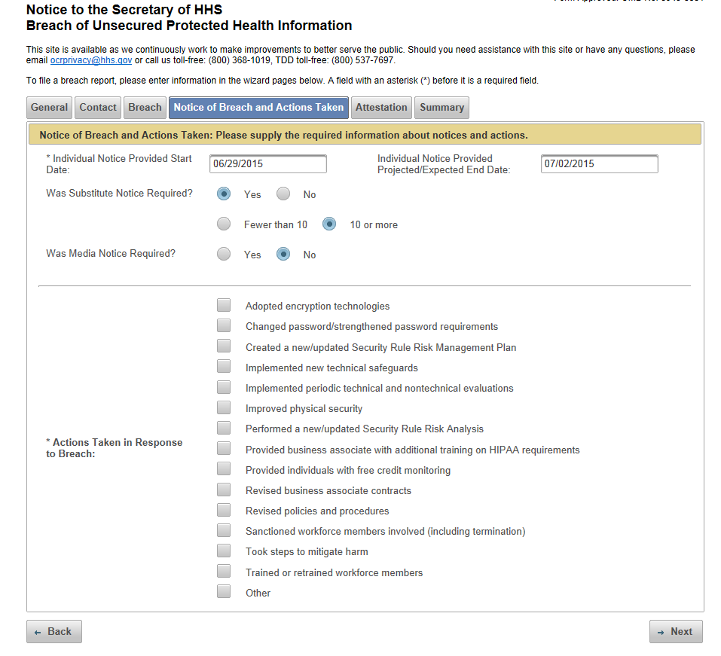
Afterparty: What To Expect When Submitting a Breach Report to The OCR
FSA 2024 – Blue Orange - Taking Control: Mastering Cybersecurity in a Digital Age

Slide 19
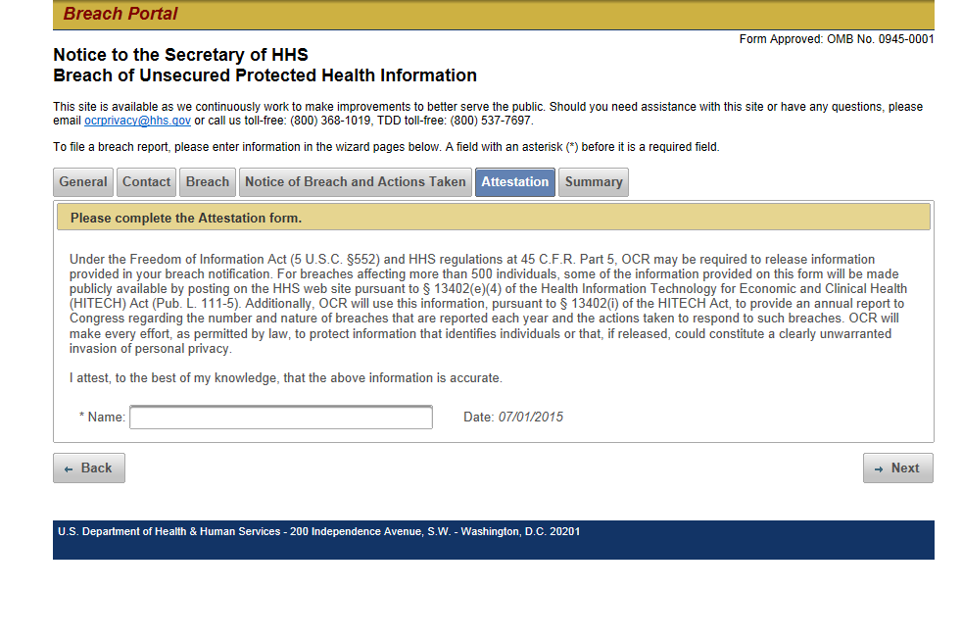
Afterparty: What To Expect When Submitting a Breach Report to The OCR
FSA 2024 – Blue Orange - Taking Control: Mastering Cybersecurity in a Digital Age

Slide 20
Afterparty – OCR - Data Request Letter
Risk Analyses
Policies, Procedures
Mitigation procedures, Risk Management evidence, ……..

Slide 21
The OCR Investigation Post Breach Report
Once an organization has reported a breach to the HHS, the OCR may/will investigate.
The OCR, may, on its own, after receiving a complaint from a third party, may initiate an investigation prior to the Breach Notification.
Request from U.S. Department of Health and Human Services (HHS), Office for Civil Rights (OCR) post breach notification.
FSA 2024 – Blue Orange - Taking Control: Mastering Cybersecurity in a Digital Age

Slide 22

Cybersecurity and Risk Management
FSA 2024 – Blue Orange - Taking Control: Mastering Cybersecurity in a Digital Age

Slide 23
Stakeholders
Residents/Patients and Their Families
Employees
Independent Contractors
Management
Board of Directors/Trustees
Vendors, Business Associates, IT Provider
Community
Cyber Insurance Carrier
Government
Class Action Plaintiff Attorneys
FSA 2024 – Blue Orange - Taking Control: Mastering Cybersecurity in a Digital Age

Slide 24
Cyber Risk Management
Within your control
Security
People
Technology
Process
Insurance
+
$Money
Functionality/Convenience
FSA 2024 – Blue Orange - Taking Control: Mastering Cybersecurity in a Digital Age

Slide 25
Risk Hedge - Cyber Insurance
Insurability Requirements/Key Factors
Multifactor Authentication(MFA)- R
Secure Remote Connectivity - R
Segregated Backups – R
Employee Training – R
Cyber Incident Response Policies and Procedures – F
Endpoint Detection and Response (EDR)/Intrusion Detection (IDS)/Next Gen Firewall – R for Revenue Exceeding $50M, Otherwise, F
Encryption for Data at Rest and in Transit – R/F
Patch Management - R
Penetration Test/Vulnerability Scans – F
Key vs Non-Key IT Vendors – F
Security Risk Assessments - F
R - Required
F - Favorable (more favorable underwriting, lower rates)
FSA 2024 – Blue Orange - Taking Control: Mastering Cybersecurity in a Digital Age

Slide 26
Cyber Insurance Policy Components
Notification, Credit Monitoring, Call Center
Network and Information Security Liability
Social Engineering
Fraudulent Wiring Instructions
Consequential Reputational Loss
Phishing
Property Business Interruption and Resulting Physical Damage
Civil Defense
FSA 2024 – Blue Orange - Taking Control: Mastering Cybersecurity in a Digital Age

Slide 27
Civil Litigation
Individual Claims
Class Actions
FSA 2024 – Blue Orange - Taking Control: Mastering Cybersecurity in a Digital Age

Slide 28
Let’s Talk About Data
What are the Crown Jewels?
Data
What is it?
Where is it?
In what form?
Who Has Responsibility?
Not an IT thing – if the Operations Department has a vector host, IT is not responsible
FSA 2024 – Blue Orange - Taking Control: Mastering Cybersecurity in a Digital Age

Slide 29
Data Strategy
First step for Security Risk Analysis
Data mapping is crucial. Failure to map data means you have no idea what information is within your control and what is not within your control.
One error in data mapping can ripple throughout your organization, leading to replicated errors and ultimately, to inaccurate analysis.
Every organization must move data between systems and share with others. For movement and consolidation of data for analysis or other tasks, a roadmap is needed to ensure the data gets to its destination accurately.
For processes like data integration, data migration, data warehouse automation, data synchronization, automated data extraction, or other data management projects, quality in data mapping will determine the quality of the data to be analyzed for insights.
FSA 2024 – Blue Orange - Taking Control: Mastering Cybersecurity in a Digital Age

Slide 30
Data Categorizations and Locations
Location/Storage
EHR
Devices
Shared drives/Cloud
Paper
Health Information
X
X
X
X
Personal
X
X
X
X
M&A/Legal
X
X
X
Categories
Trade Secrets
X
Public
X
X
X
X
FSA 2024 – Blue Orange - Taking Control: Mastering Cybersecurity in a Digital Age

Slide 31
Security Practices Terminology
Reasonable Security Practices (Minimum)
“The HIPAA Security Rule sets standards for protecting electronic protected health information (ePHI) that are designed to ensure that covered entities (e.g., healthcare providers, health plans, and healthcare clearinghouses) implement appropriate safeguards to protect the confidentiality, integrity, and availability of ePHI.”
Recognized Security Practices (Recommended)
Mitigation of Penalties
Improved Defense
Regulatory Compliance
Best Practices Under Section 405(d) of the Cybersecurity Act of 2015
Demonstrate that it has implemented recognized security practices for at least the previous 12 months
FSA 2024 – Blue Orange - Taking Control: Mastering Cybersecurity in a Digital Age

Slide 32
Security Practices Examples
Reasonable Security Practices (Minimum)
Risk Analysis and Management
Access Control Measures
Encryption of ePHI
Workforce Training and Security Awareness
Incident Response Planning
Recognized Security Practices (Recommended)
Email Protection
Endpoint Protection (ex SentinelOne)
Data Loss prevention
Physical Controls
Technical Safeguards
Backup and Disaster Recovery
Third party/Vendor Management
Patch Management
Access Management (ex MFA)
Asset Management
Network Management
Vulnerability Management (ex penetration testing)
Incident Response
Medical Device Security
Cybersecurity Policies (aligns with “Recognized”
FSA 2024 – Blue Orange - Taking Control: Mastering Cybersecurity in a Digital Age

Slide 33
HIPAA Security Risk Assessment – NOT Just an Assessment
Scope and Data Collection
Identification of systems (not just electronic health records and practice management)
Data Mapping
Use recognized framework (NIST – example)
Identification and Document Potential Threats and Vulnerabilities
Threats: potential for a person to thing to trigger a vulnerability
Vulnerabilities: flaw or weakness in system security procedures, design, implementation or internal controls
Consider: Penetration and Vulnerability Testing
Examples of Threats/Vulnerabilities: Ransomware, BEC, Flood, Lost Personal Device
Asses Current Measures and Likelihood of Threat Occurrence
Documented Policies
Documented Procedures
Incident Response Plan
Disaster Recovery/Business Continuity
Document all threats and likelihood
Potential Impact of Threat Occurrence
Criticality Assessment
Magnitude of Impact
Determine Level of Risk
Risk Levels
Corrective Action Plans
FSA 2024 – Blue Orange - Taking Control: Mastering Cybersecurity in a Digital Age

Slide 34
Technical Testing – Validation (House Example)
Vulnerability Scanning – Jiggling the handles
Penetration Testing – Knocking the door down
External – Can I get indie your house?
Internal – Once inside, what can I steal?
FSA 2024 – Blue Orange - Taking Control: Mastering Cybersecurity in a Digital Age

Slide 35
Compliance/Security – Journey, Not a Destination
Assess/Test
Manage/Prioritize
Remediate
FSA 2024 – Blue Orange - Taking Control: Mastering Cybersecurity in a Digital Age

Slide 36
Take Control
Pre-Attack/
Incident “Left of Boom”
Cyber Attack/ Incident
Post-Attack/ Breach “Right of Boom”
Business Continuity Plan
Everything from “Pre-attack” list
HIPAA Security Risk Assessment (external recommended)
Adequate Polices and Procedures
Adequate technical controls
Cyber governance/risk management program
Technical Testing - Penetration Testing, Vuln Scanning
Training
Adequate cyber insurance
Data categorization/inventory
Governance
Incident Response Plan
Disaster Recovery
FSA 2024 – Blue Orange - Taking Control: Mastering Cybersecurity in a Digital Age

Slide 37
Evaluate Your Board’s Role in Cyber Risk Management
Embed Cyber Risk in Strategic Decisions
Understand the Cyber Risk Management Program
Monitor Cyber Resilience
Evaluate the Board’s Cyber Oversight Allocation
FSA 2024 – Blue Orange - Taking Control: Mastering Cybersecurity in a Digital Age

Slide 38
Cybersecurity and AI in Healthcare
FSA 2024 – Blue Orange - Taking Control: Mastering Cybersecurity in a Digital Age

Slide 39
Artificial Intelligence (AI) and Cybersecurity
Big Topic
Uses in Senior living
Implement Policies and Procedures around the Use of AI within your organization (Base policy provided)
FSA 2024 – Blue Orange - Taking Control: Mastering Cybersecurity in a Digital Age

Slide 40
Some AI Use Examples
Save Time
First Drafts
Research – Pass 1
Summaries
Meetings (Co-pilot, Zoom)
Long text
Fall Prevention Tech, etc.
Clinical
Robotic Process Automation (Not quite AI)
FSA 2024 – Blue Orange - Taking Control: Mastering Cybersecurity in a Digital Age

Slide 41
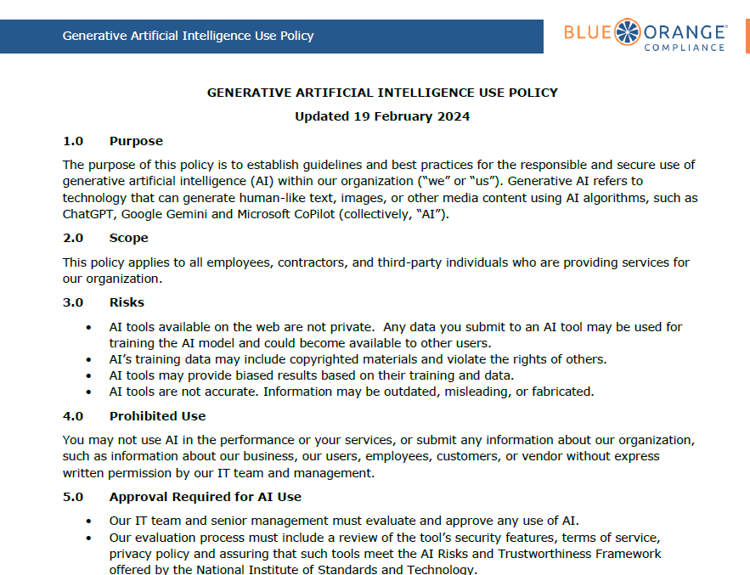
Policy Example – Generative AI Use
FSA 2024 – Blue Orange - Taking Control: Mastering Cybersecurity in a Digital Age

Slide 42
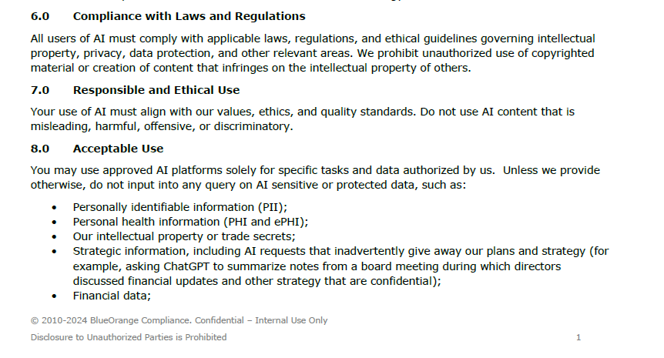
Policy Example – Generative AI Use
FSA 2024 – Blue Orange - Taking Control: Mastering Cybersecurity in a Digital Age

Slide 43
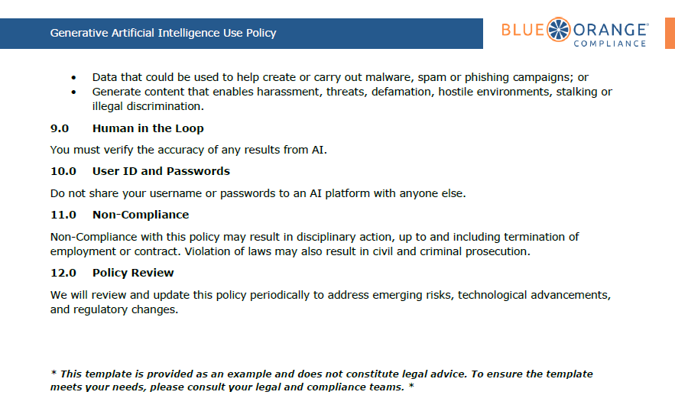
Policy Example – Generative AI Use
FSA 2024 – Blue Orange - Taking Control: Mastering Cybersecurity in a Digital Age

Slide 44
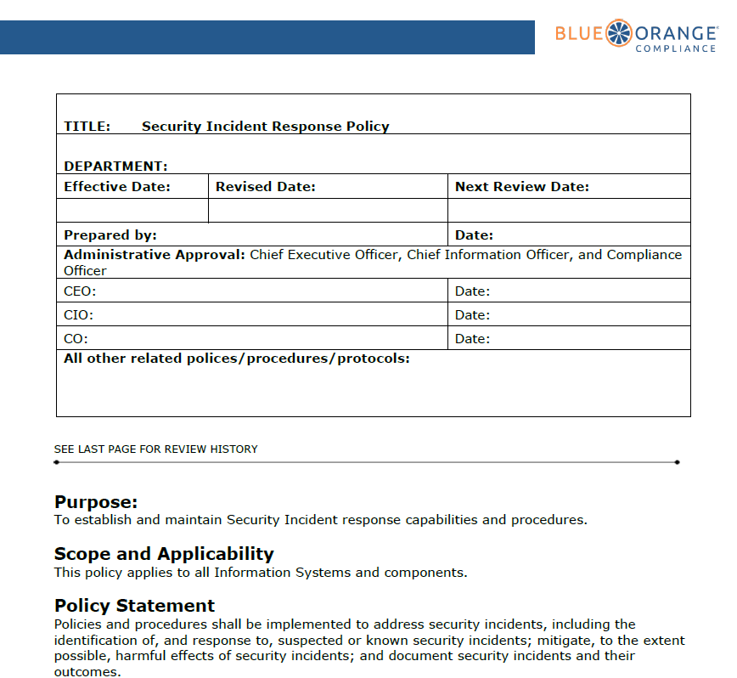
Policy Example – Incident Response
FSA 2024 – Blue Orange - Taking Control: Mastering Cybersecurity in a Digital Age

Slide 45
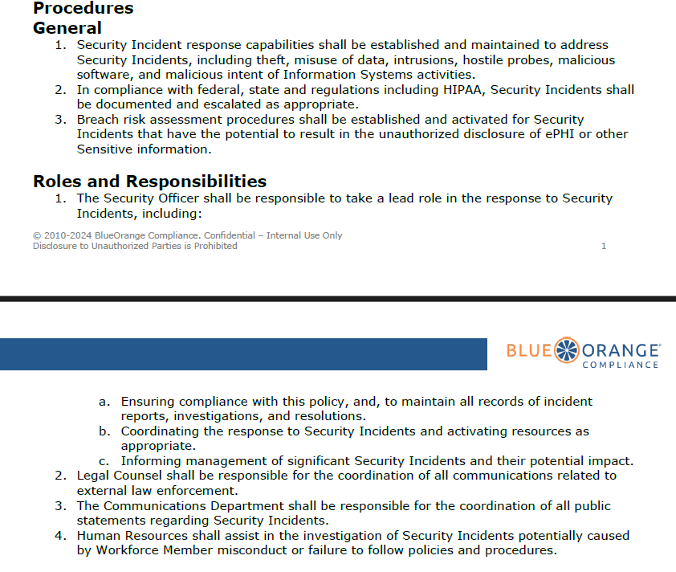
Policy Example – Incident Response
FSA 2024 – Blue Orange - Taking Control: Mastering Cybersecurity in a Digital Age

Slide 46
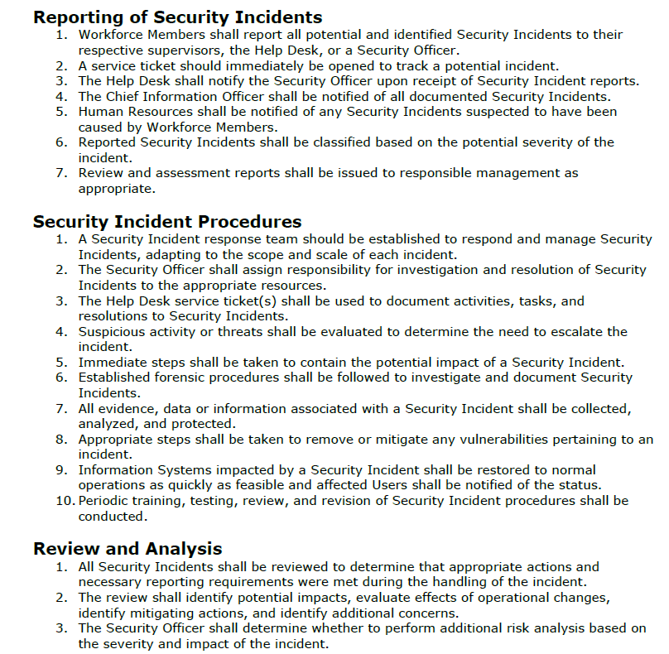
Policy Example – Incident Response
FSA 2024 – Blue Orange - Taking Control: Mastering Cybersecurity in a Digital Age

Slide 47
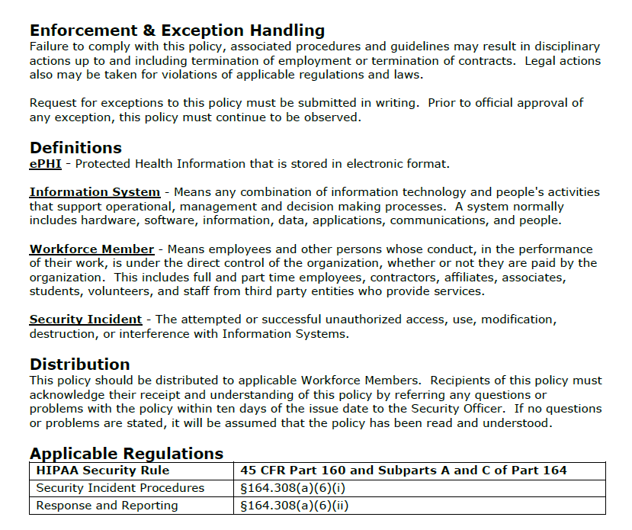
Policy Example – Incident Response
FSA 2024 – Blue Orange - Taking Control: Mastering Cybersecurity in a Digital Age

Slide 48
John DiMaggio CEO, Blue Orange Compliance john.dimaggio@blueorangecompliance.com 2500 Farmers Drive Columbus, OH 43245 614.567.4109
Thank You

