Slide 1



navigating medicare advantage
and why it matters !

Slide 2



presenting today
Chuck Maines, BSW, MBA, NHA
vice president
P.O. Box 4485 | Lancaster, PA 17604
Phone: 717-509-9716 | Fax: 717-509-9717
Website: www.kairoshealthsystems.com
cmaines@kairoshealthsystems.com

Slide 3



objectives
In this session we will …
Briefly explore the history and growth of
Medicare Advantage enrollment
Focus on compliance concerns and how to navigate
an individual’s stay through:
    Prior authorization
    NOMNC (notice of Medicare non-coverage)
    Notice of financial responsibility
Review ways your facility may be able to
improve outcomes through tracking of appeals.

Slide 4
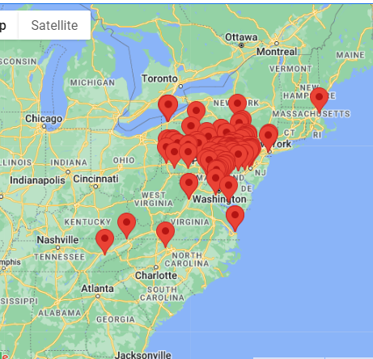
OUR PERSPECTIVE INCLUDES…
home & community-based services
    adult day
    home infusion
    in-home care
home health agencies
hospice care
skilled nursing facilities
in states including:
maryland
massachusetts
new jersey
new york
as well as in discussions with prospective
members in several other states!
over 120 plus members (entities)
being served
7
north carolina
pennsylvania
virginia

Slide 5
medicare advantage
(ma)
Also known as Medicare Part C

Slide 6
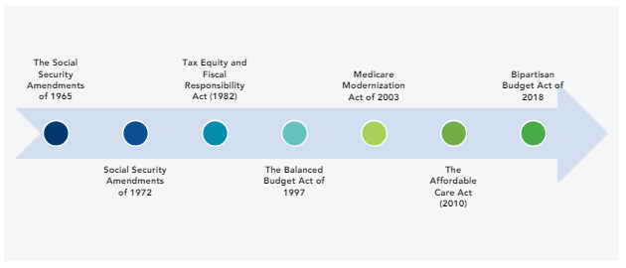
medicare advantage
history : Legislative Milestones
Tax Equity and Fiscal Responsibility Act (1982)
The Social Security Amendments of 1965
Medicare Modernization Act of 2003
Bipartisan Budget Act of 2018
Social Security Amendments of 1972
The Balanced Budget Act of 1997
The Affordable Care Act (2010)

Slide 7

milestones
1997
  The Balanced Budget Act of 1997 (BBA 97)
    Created Medicare Part C–originally called Medicare+Choice
    Now known as Medicare Advantage
    Made significant changes to Medicare’s interactions with managed care plans.
  The Patient Protection and Affordable Care Act (ACA),
    Brought MA payments closer to OM spending level
    Reduced rates overall
  CMS Innovation Center
  Established by Congress to identify ways to:
    improve healthcare quality
    Reduce costs in the Medicare, Medicaid, and Children’s Health Insurance Programs (CHIP) programs.
2010
2010

Slide 8
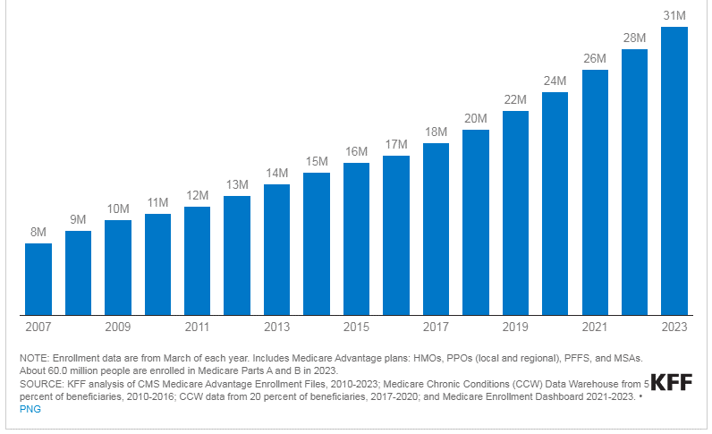
medicare advantage
enrollment
Total Medicare Advantage Enrollment 2007-2023

Slide 9
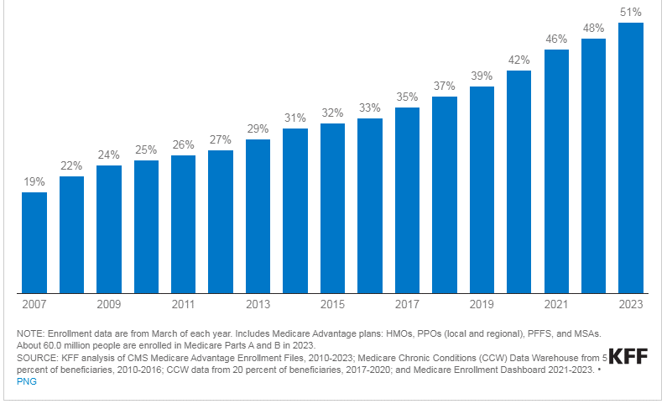
medicare advantage
penetration
Total Medicare Advantage Enrollment 2007-2023

Slide 10
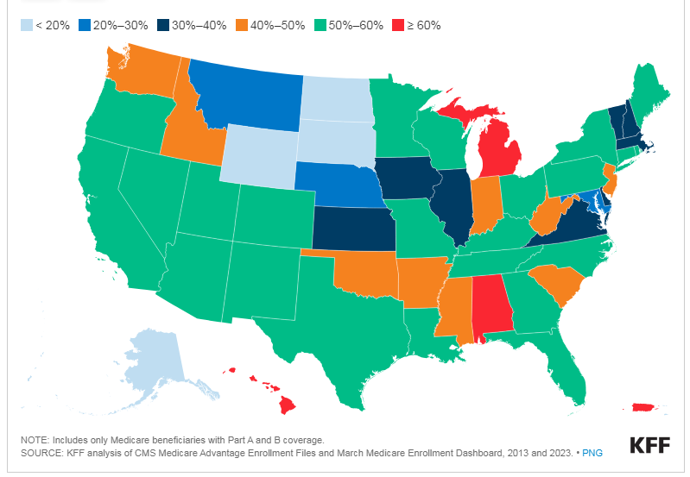
medicare advantage
penetration
Share of Beneficiaries Enrolled in Medicare Advantage in 2023 by State
Notes:
24%

Slide 11
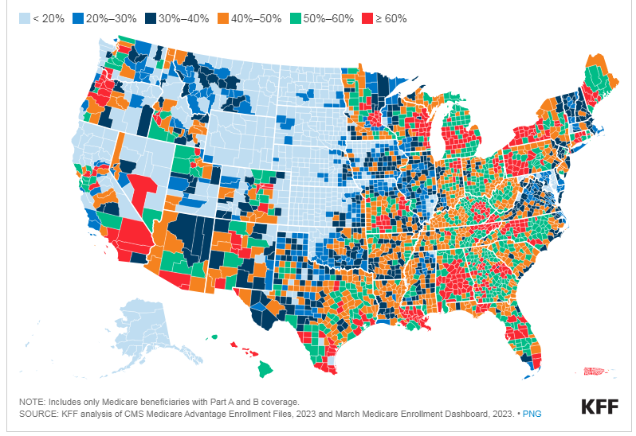
medicare advantage
penetration
Medicare Advantage Penetration by County 2023

Slide 12

why is MA enrollment growing
And why does it matter?
People with Medicare are drawn to MA for the extra benefits.
People with Medicare are drawn to MA plans that are marketed as “zero premium” products.
Premiums for Part D stand-alone prescriptions drug plans that supplement traditional Medicare are rising rapidly.
People with Medicare are attracted to the financial protection that comes with an annual out-of-pocket limit that MA plans are required to provide.
Beyond financial benefits, people with Medicare are attracted to the simplicity and convenience of MA.

Slide 13
why is MA enrollment growing
And why does it matter (cont’d)
Insurers are marketing MA aggressively
Brokers have a financial incentive to encourage enrollment in MA plans
A growing share of large employers are shifting their Medicare- age retirees into Medicare Advantage plans for both Medicare and supplemental benefits
Medicare beneficiaries may be reluctant to switch from MA to traditional Medicare if they run the risk of being denied a Medigap policy due to a pre-existing condition
Beneficiaries may not be familiar with potential trade offs in choosing MA over traditional Medicare

Slide 14
medicare advantage
Types of Plans
HMO
Health Maintenance Organization
MSA
Medicare Savings Account
PFFS
Private Fee-for-Service
PPO
Preferred Provider Organization
SNP
Special Needs Plan
  CSNP (Chronic Condition)
  DSNP (Dual Eligible)
  ISNP (Institutional)
PACE (LIFE)
Program of All-Inclusive Care for the Elderly (Living Independence for the Elderly)

Slide 15
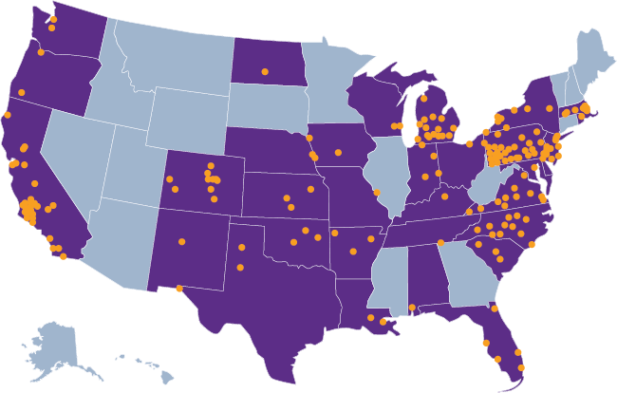
pace in the united states
As of July 2024…
171 PACE programs
operating in 33 states and D.C.
More than 300 centers serving nearly 76,000 participants

Slide 16
ACO
Accountable Care Organization
Notes:
Overall, in 2024 there are about 13.7 million people with Traditional Medicare aligned to an ACO.

Slide 17
accountable care organizations
(ACOs)
An ACO is a group clinicians, working together, equipped with better tools and preferred payer partnerships, that reward then for improving the quality and cost of care.
Accountable Care Organizations Realizing Equity, Access and Community Health (ACO REACH) – Though ACOs are not Medicare Advantage plans, skilled nursing facilities (SNFs) may choose to align with them as part of a Preferred Provider Network. This often requires the signing of a Preferred Provider Agreement. Though the Medicare beneficiaries, individual, continue to have choice in SNF placement, the Preferred Providers are often presented to the individual as a preferred tier for placement, and these providers in consultation with the ACO participating hospitals and physicians have the potential to provide access to skilled care through a 3-day SNF rule waiver. In accordance with the Centers for Medicare & Medicaid Services (CMS) requirements, Preferred Providers must have and maintain an overall rating of 3 stars or higher in seven of the previous twelve months as reported under the CMS 5-star Quality Rating System.
Notes:
As of 2021, 9,894,008 (about 10 million) Medicare beneficiaries throughout the United States were assigned to an ACO – in Maryland 72,833.
As health insurers such as Clover, CVS Health (Aetna), Centene Corporation (Wellcare), and Provider Partners Health Plans now have ACO REACH models.

Slide 18

alternative payment
models
Healthcare capitation
Episodic care models
Quality initiatives
Social determinants of health (SDoH)
Others

Slide 19


admissions is not a
person in a department
it is a process

Slide 20





admissions flow example
Check: Insurance Eligibility
Check:
Patient Record
Check:
Medical and Pharmacy Requirements
Request: Insurance Authorization
Hospital
Check: Clinical Records
Check: Bed Availability
2
2
1
1
3
4
4
3
Fax, e-fax, or phone call
Send to Admission Coordinator
Intake Process
Admissions/
Clinical Liaison
Pre-discharge referral
SNF Makes Bed Offer
6
5
6
5
Patient Accepts Offer
Referral Portal
Patient
Notes:
Focusing today on the Intake which requires the verification of the insurance, importantly the Highmark Blue Card; Skilled Nursing Intake flow. The circled numbers denote the temporal ordering of a referral, starting at the Hospital and ending with the patient accepting an offer from the Skilled nursing facility (SNF)

Slide 21

educate admissions team
Verification
of hospital admissions
vs.
Observation Stays
Medicare Outpatient Observation Notice
(MOON)
  Hospitals and Critical Access Hospitals (CAHs) are required to provide a MOON to Medicare beneficiaries (including Medicare Advantage health plan enrollees) informing them that they are outpatients receiving observation services and not inpatients of a hospital or critical access hospital.

Slide 22

establish admissions team
  It can serve as a…
    Pre-Admissions Review Team
    Triple Check Review team just prior to claims submission to Medicare and third-party insurance carriers.
  The Admissions Team should include:
      Admissions
      Social Services
      Therapy
      DON/ADON – MDS (RNAC)
      Business Office
      any others who play a vital role in the facility decision making process.

Slide 23

medicare and medicare advantage
Requirements for skilled care coverage – especially Part A admissions
Be sure that the following meet requirements for medical necessity and documentation of services.
  Assessments
  Evaluations
  And Decisions
Notes:
An assessment includes collecting information about:
Your current physical and mental condition
Your medical history
Medications you're taking
How well you can do activities of daily living (like bathing, dressing, eating, getting in and out of bed or a chair, moving around, and using the bathroom)
Your speech
Your decision-making ability
Your physical limitations (like problems with your hearing or vision, paralysis after a stroke, or balance problems)
Evaluations in Therapy PT, OT, ST as needed
Decisions-discharge planning starts day one, what level should we be pushing for etc.-Higher acuity patient

Slide 24






insurance information
Obtain insurance information and verifications for ALL admissions
Understand the process, address and claims submissions process for payers.
Residents may have multiple cards in their wallet/handbag. Verify coverage to ensure that the proper payer is identified & billed.
Date the copies.
Get copies of all insurance cards.
Contact carriers to verify coverage, co-pays, limits & requirements for authorizations & certifications for care & services provided.
Some payers require
pre-authorization followed by a call within 24 hours following admission.
Notes:
retirement plans sometimes have a co-pay at entry rather than day 21

Slide 25
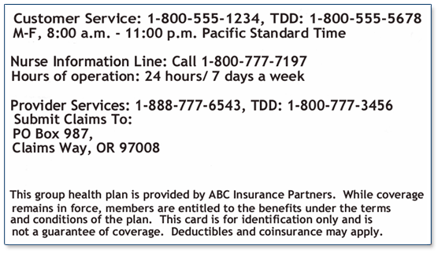
insurance card
Plan Type
ABC Insurance Co. PPO
Policy No. Office Visits: $20
123456789 Specialist: $ 40
Group NO. Emergency: $ 100
A875432 Urgent: $ 50
Group Name RX: $10/20/40
XYZ Company
Network Co-Insurance
Member Name In 80% / 20%
Susan J. Sample Out 70% / 30%
Policy
Copays
Phone
In/Out Network
Member
Claims
Notes:
When at all possible collect copies of the Medicare (red, white, and blue) card as well as the managed care card, the Medicare ID is still needed for SNF billing of HMO paid claims. Insurance cards it is important to get both the front and back copies of the card, your system may have an old or out dated address that you are sending claims to and if you reach timely filing without sending claims to the correct address this does not afford appeal rights. Also, with managed care plans it will show some of the important information such as: type, policy #, co-pays, Member name, and co-insurance for in and out-of network providers.

Slide 26

insurance verification
Eligibility Verification Tools
HIPPA Eligibility Transaction System (HETS)
FISS
Interactive Voice Response (IVR)
Inovalon (formerly MyAbility)
Point Click Care
Availity
Novitasphere (DE, MD, NJ, PA)
Navinet
Waystar
Payer Website
Call to insurance company
Coverage & Limitations
Skilled Days
Benefit Detail
Requirement for authorization or notice of services
Patient Financial Responsibility
Co-Payment
Co-Insurance
Deductible
ABN/NOMNC
Notes:
You want to insure the individuals you bring in have the appropriate insurance coverage through a verification process (share/ask about a form that they may use). You want to verify the insurance that they present is what the Medicare system has and if not question that prior to their arrival. You want to review the skilled days ( which may differ from the Medicare system if claims aren’t yet filed by the previous facility, in which case be in touch with the family, and the benefit details as there maybe limitations on the # of days certain plans provide as well as the authorization process. There are sometimes secondary payors that require a pre-auth. for co-insurance. You want to let them know as best you can what out-of-pocket expenses may be incurred during the stay whether it be co-pays, deductibles, or co-insurance. You need to know what end of stay documents are needed such as the ABN NOMNC which we will go over further.

Slide 27


Authorization process
Care Management
Validate Level Approved
Additional Services & Carve Outs
Obtain & Document the Authorizations
Prior to Admission
Change of Condition
Discharge from Hospital
Notes:
Check on this slide

Slide 28
…case management
At the point of admission, the provider should…
  Conduct initial assessments (including MDS)
  within 24 to 72 hours
  Consult clinical pathways as well as any
  predict outcome tools
  Start stairs training (2 to 3 steps) on day 1
  Therapy home evaluation between day 5 and 7
  Develop a baseline care plan within 48 hours
  Start discharge planning

Slide 29
medicare secondary payer (msp)
All Admissions
Notes:
Complete an MSP form for all admits (not just Part A) to capture any outliers—show CMS form for MSP

Slide 30
who pays first?
Group Health Plan Scenarios (GHP) for 65 and older with Medicare
Medicare
GHP
pays first when…
pays first when…
GHP employer has less than 20 employees
GHP exists and the individual isn’t working (retiree-not working)
Individual is disabled and has a GHP through a current employer or family member’s employer with less than 100 employees
GHP through working aged spouse’s employment and has more then 20 employees*
Individual is disabled and has a GHP through a current employer or family member’s employer with greater than 100 employees (note: Medicare may pay secondary)
Notes:
*Employer has 20 or more employees or is part of a multiple or multi-employer group with at least 1 employer employing 20 or more people

Slide 31
who pays…
with ESRD and Black Lung (FBLP)?
ESSRD & GHP
Coverage
Medicare
Coverage
Group Health Plan (GHP) pays Primary to Medicare before the person entitled based to Medicare based on the ESRD diagnosis(N18.6)-Z-code relating to dialysis
30 months of Medicare eligibility or entitlement before Medicare pays
ESRD and Consolidated Omnibus Budget Reconciliation Act (COBRA)-First 30 months prior to Medicare entitlement
Group Health Plan (GHP) pays Primary to Medicare before the person entitled based to Medicare based on the ESRD diagnosis(N18.6)-Z-code relating to dialysis
30 months of Medicare eligibility or entitlement before Medicare pays
ESRD and Consolidated Omnibus Budget Reconciliation Act (COBRA)-First 30 months prior to Medicare entitlement
ESRD: Medicare will pay after 30 months of Medicare eligibility or entitlement
Black Lung: Medicare covers only those services not related to the black lung diagnosis (J60)

Slide 32
COBRA
Consolidated Omnibus Budget Reconciliation Act of 1985
Individual has ESRD, is covered
by COBRA and is in the first
30 months of eligibility or entitlement to Medicare
COBRA pays Primary,
Medicare pays secondary
during 30-month coordination
period for ESRD
Individual is age 65 years or older and covered by Medicare
& COBRA:
Medicare pays Primary,
COBRA pays secondary
Individual is disabled and
covered by Medicare & COBRA:
Medicare pays Primary,
COBRA pays secondary

Slide 33
other msp scenarios
Retiree Health Plans
Individual is age 65 or older and has an employer retirement plan:
Medicare pays Primary
Retiree coverage pays secondary
No-fault Insurance and Liability Insurance
Individual is entitled to Medicare and was in an accident or other situation where no-fault or liability insurance is involved.
No-fault or Liability Insurance pays Primary for accident or other situation related health care services claimed or released
Medicare pays secondary
Workers’ Compensation Insurance
Individual is entitled to Medicare and is covered under Workers’ Compensation because of a job-related illness or injury:
Workers’ Compensation pays Primary for health care items or services related to job-related illness or injury claims.
Notes:
Mention benefit exhausts; WC details Medicare generally will not pay for an injury or illness/disease covered by workers’ compensation. If all or part of a claim is denied by workers’ compensation on the grounds that it is not covered by workers’ compensation, a claim may be filed with Medicare. Medicare may pay a claim that relates to a medical service or product covered by Medicare if the claim is not covered by workers’ compensation. Prior to settling a workers’ compensation case, parties to the settlement should consider Medicare’s interest related to future medical services and whether the settlement is to include a Workers’ Compensation Medicare Set-aside Arrangement (WCMSA). Federal law takes precedence over state laws and private contracts. Even if an entity believes that it is the secondary payer to Medicare due to state law or the contents of its insurance policy, the MSP provisions would apply when billing for services.

Slide 34

provider responsibility
Under MSP
As a Part A institutional provider (i.e., hospitals SNF’s), you should:
Obtain billing information prior to providing services.
  It is recommended that you use the CMS questionnaire, or a questionnaire that asks similar types of questions
Submit any MSP information to the intermediary using condition and occurrence codes on the claim.

Slide 35
skilled medicare benefit
Medicare or Medicare Advantage (Part A)

Slide 36

communication is crucial
If services will not be covered by Medicare or Medicare Advantage plans, the beneficiary MUST be notified, verbally and in writing, immediately.
Communicate!
It is the responsible of the healthcare provider (skilled nursing facility) to communicate with the beneficiary’s the coverage benefits in advance.
Communicate!
Communicate!
Admitting an individual to a skilled nursing facility, the prospective of the Center for Medicare & Medicaid Services (CMS) is that the services being provided to the beneficiary are covered by Medicare.
Notes:
Check on this slide

Slide 37

justifying a skilled day
Nurses must ask themselves these
questions
(and document the answers)
each and every day
Why is this patient here?
What is preventing this patient from going home right now?
  Could this patient go home right now and be safe and independent?
  Why not?
What are you doing that would not or could not happen for this patient at home?
Have you noticed this patient improving in any aspect of mobility? Self-care? Communication?
*Even minor improvements
need to be noticed and documented.

Slide 38
justifying a skilled day cont’d
Nurses must ask themselves these
questions
(and document the answers)
each and every day
Why is this patient receiving PT, OT or ST?
What would/could happen if this patient was not an inpatient receiving care?
What are all of the medical complexities that are impacting this patient’s recovery.
  Explain the multiple conditions that you are managing.
  What is making this patient’s recovery take this amount of time?

Slide 39
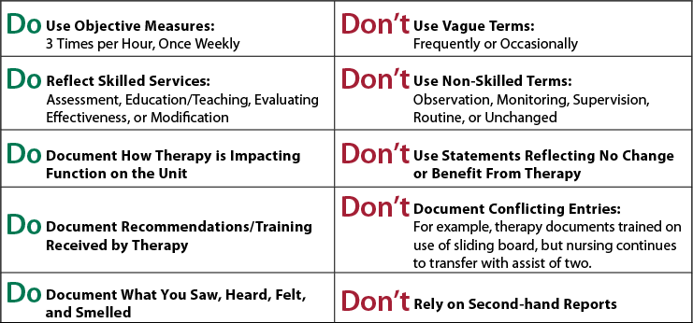
documentation
do’s and don’ts

Slide 40
right to notice and appeals
Advance Beneficiary Notice of Noncoverage (ABN) for Medicare
ABN may result in a request for a Medicare demand bill.
Only use the ABN form with “Original” Medicare.
Per CMS, the use of the form for Medicare Advantage plans is an improper use of the ABN.
“Best Practice” Notice of Financial Responsibility for Medicare Advantage
Notice of Medicare
Non-coverage (NOMNC) for Medicare & Medicare Advantage
Medicare beneficiaries have the right to an immediate, independent medical review (appeal) of the decision to end Medicare coverage of skilled care services.
Notes:
But keep in mind, by contract, that the skilled nursing facility is still required to provide a Notice of Financial Responsibility to a Medicare Advantage resident when ending skilled care coverage/services.

Slide 41

abn
Advance Beneficiary Notice of Noncoverage
Also known as a waiver of liability, is a notice a provider should give before the resident receives a service if, based on Medicare coverage rules, the SNF has reason to believe Medicare will not pay for the service.
  At admission (when a service begins/starts)
  AND at discharge (when a skilled service ends)

Slide 42
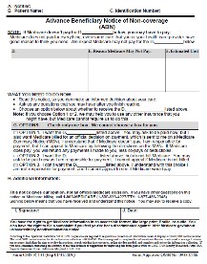
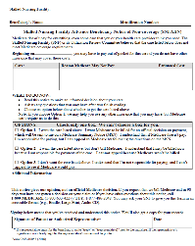
advance beneficiary notice
(ABN)
Patient Responsibility Form
When to Complete:
You believe Medicare may not pay for an item or service because:
Medical equipment or supplies denied in advance
Program considers care to be custodial care
Hospice care provided to a patient who is not terminally ill
Outpatient therapy services are in excess of therapy cap amounts and do not qualify for a therapy cap exception
Change in level of care (i.e. skilled need no longer needed but remaining in the facility)
Notes:
Reminder

Slide 43
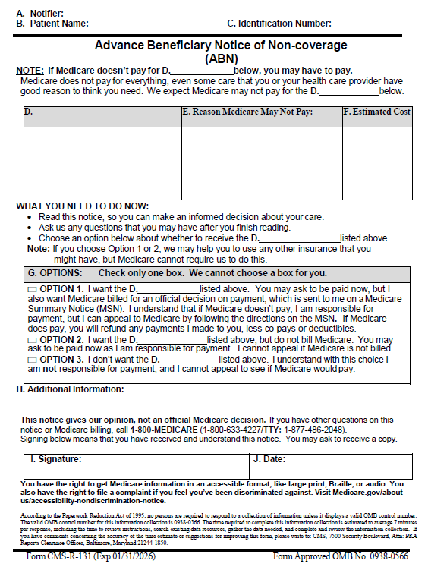
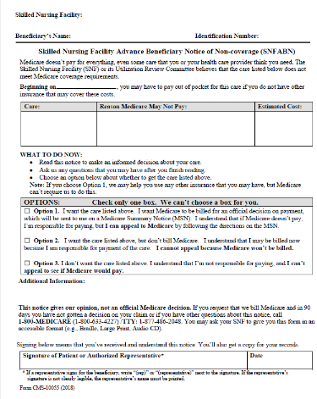
ABN
Advanced beneficiary notice of Noncoverage

Slide 44
ABN
It is not to be used for all admissions, only those for whom:
there is an expectation that the resident will have financial liability
are Original Medicare
Complete the Advanced Beneficiary Notice (ABN) appropriately
Notes:
Reminder

Slide 45
NOMNC
Notice of Medicare Non-Coverage
HHAs, SNFs, Hospice and COFRFs are required to provide a Notice of Medicare Non-Coverage to beneficiaries when their Medicare covered services(s) are ending.
Who?
When?
  Must be delivered
  at least two calendar days before Medicare covered services end
  or
  the second to last day of service if care is not being provided daily.
  Note: The two day advance requirement
  is not a 48 hr. requirement.
A Medicare provider or health plan (MA) must deliver a completed copy to beneficiaries/ enrollees receiving:
Covered skilled nursing
Home health (including psychiatric home hth.)
Comprehensive outpatient rehab facility
Hospice services
Notes:
The NOMNC informs beneficiaries on how to request an expedited determination from their Beneficiary and Family Centered Care Quality Improvement Organization (BFCC-QIO) and gives beneficiaries the opportunity to request an exped

Slide 46

NOMNC (cont’d)
Exceptions: The following service terminations, reductions, or changes
in care are not eligible for an expedited review.
Providers should not deliver a NOMNC in these instances.
When beneficiaries…
    never received Medicare covered care in one of the covered settings
    are moving to a higher level of care
    exhaust their benefits
    end care on their own initiative
    transfers to another provider at the same level of care
Notes:
When beneficiaries…
never received Medicare covered care in one of the covered settings (e.g., an admission to a SNF will not be covered due to the lack of a qualifying hospital stay or a face-to-face visit was not conducted for the initial episode of home health care).
are moving to a higher level of care(e.g., home health care ends because a beneficiary is admitted to a SNF)
exhaust their benefits (e.g., a beneficiary reaches 100 days of coverage in a SNF, thus exhausting their Medicare Part A SNF benefit).
end care on their own initiative (e.g., a beneficiary decides to revoke the hospice benefit and return to standard Medicare coverage).
transfers to another provider at the same level of care (e.g., a beneficiary transfers from one SNF to another while remaining in a Medicare-covered SNF stay).

Slide 47
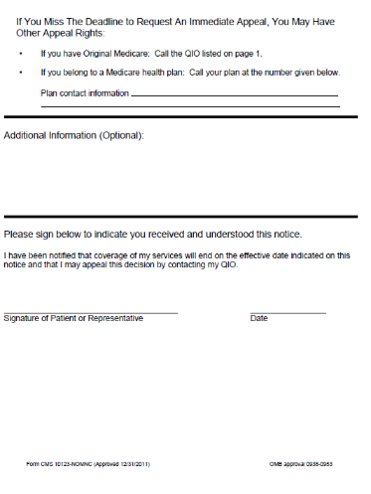
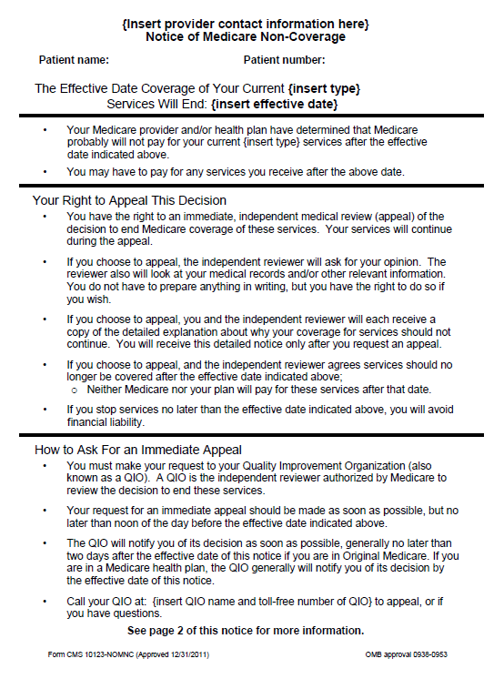
nomnc
notice of medicare
non-coverage

Slide 48
organization determination
Patient responsibility form - Explained
  An “Organization Determination,” or Medical Prior Authorization…
  is a decision an insurance company makes about medical benefits and coverage or about the amount they will pay for medical services. This means the plan to authorize, provide, or pay for medical services. Insurance wants to make sure members are getting the type or level of services expected:
      Authorization or payment for a health care item or service;
      The amount a health plan requires an enrollee to pay for an item or service; or
      A limit on the quantity of items or services.
  Allows the Insurance plan to:
      Check that you can get the service you asked for through your benefit package
      Review services for Medical Necessity
      Review Services to make sure they are given by the appropriate provider in an appropriate setting
      Make sure ongoing and recurring services are helping the individual
Notes:
Pause for questions

Slide 49
medical prior authorization
Examples of services that may need Medical Prior Authorization are:
Home Health Care (HHC)
Specialist or Specialty Care Visits (other than your PCP)
Infusions
Outpatient surgical procedures
Durable Medical Equipment (DME)
Non-emergent ambulance transport
Outpatient diagnostic testing
Outpatient therapy

Slide 50
External audits
And Provider Responsibilities
CERT
Certified Error Rate Testing
review a sampling of claims to see that they paid correctly
TPE
Targeted Probe & Educate
Educate-MAC’s work with providers to identify & correct errors. Designed to detect common billing errors & inconsistencies
Pre and Post Payment Audits
RAC
Recovery Audit Contractors
used by CMS to recover inappropriate Medicare payments
Probe Audits
target specific services and specialties

Slide 51
External audits
And Provider Responsibilities
CERT
Certified Error Rate Testing
review a sampling of claims to see that they paid correctly
TPE
Targeted Probe & Educate
Educate-MAC’s work with providers to identify & correct errors. Designed to detect common billing errors & inconsistencies
Pre and Post Payment Audits
RAC
Recovery Audit Contractors
used by CMS to recover inappropriate Medicare payments
Probe Audits
target specific services and specialties

Slide 52
External audits
And Provider Responsibilities
CERT
Certified Error Rate Testing
review a sampling of claims to see that they paid correctly
TPE
Targeted Probe & Educate
Educate-MAC’s work with providers to identify & correct errors. Designed to detect common billing errors & inconsistencies
Pre and Post Payment Audits
RAC
Recovery Audit Contractors
used by CMS to recover inappropriate Medicare payments
Probe Audits
target specific services and specialties

Slide 53
External audits
And Provider Responsibilities
CERT
Certified Error Rate Testing
review a sampling of claims to see that they paid correctly
TPE
Targeted Probe & Educate
Educate-MAC’s work with providers to identify & correct errors. Designed to detect common billing errors & inconsistencies
Pre and Post Payment Audits
RAC
Recovery Audit Contractors
used by CMS to recover inappropriate Medicare payments
Probe Audits
target specific services and specialties

Slide 54
other provider responsibilities
NPPES NPI Registry should be updated when any of the following are changed at a SNF:
  Authorized Official
  Mailing Address or Primary Address, phone or fax numbers
  Taxonomy Codes added
  Verify your information @ https://npiregistry.cms.hhs.gov/provider-view/1720332653
PECOS System-Medicare Revalidations
  Review information currently on file
  Upload Supporting documentation
  Electronically sign and submit revalidation
  https://pecos.cms.hhs.gov/pecos/login.do#headingLv1
  You should receive a letter for revalidation to check is you are due follow this link https://data.cms.gov/tools/medicare-revalidation-list

Slide 55
resources
Novitas-MAC JL (for DC, DE, MD, NJ, PA)
https://www.novitassolutions.com/webcenter/portal/MedicareJL
Availity ®
https://www.availity.com/
CGS Medicare-MAC Jurisdiction 15 (OH and KY) and HHH MAC (DE, MD, PA VI, WV)
https://www.cgsmedicare.com/
Palmetto GBA-MAC Jurisdiction J (TN) and M (NC, SC, VA, WV)-RailRoad
https://www.palmettogba.com/
Medicare Coverage Database: https://cms.gov/medicare-coverage-database/search .aspx
How to use the Medicare Coverage Database-MLN901347:
https://www.cms.gov/Outreach-and-Education/MLN/Educational-Tools/MLN901347-How-to-MCD/mcd/mcd/index.html
Medicare Claims Processing Manual:
https://www.cms.gov/regulations-and-guidance/guidance/manuals/internet-only-manuals-ioms-items/cms018912
Notes:
CGS has a nice consolidated billing tool where you can run HCPCS to see if excluded from consolidated billing—Palmetto has a nice tools area and has a PDPM calculator

Slide 56

questions?
P.O. Box 4485 | Lancaster, PA 17604
Phone: 717-509-9716 | Fax: 717-509-9717
Website: www.kairoshealthsystems.com

Slide 57
thank you!
Chuck Maines, BSW, MBA, NHA
vice president
P.O. Box 4485 | Lancaster, PA 17604
Phone: 717-509-9716 | Fax: 717-509-9717
Website: www.kairoshealthsystems.com
cmaines@kairoshealthsystems.com

